Slide 1
Computational Genomics: Finding Ghost Loci
Jasmine Mah
April 18, 2019
Notes:
Note: a proof of concept talk. Things did not fully go to plan so much of the results have been run on only a subset of the data.

Slide 2
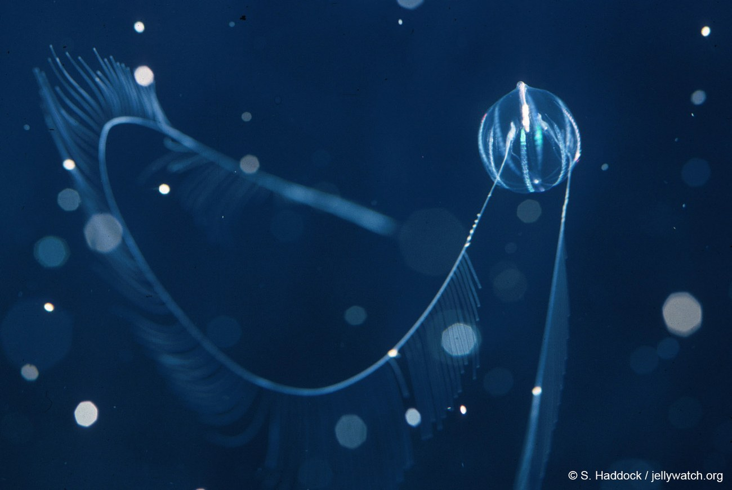
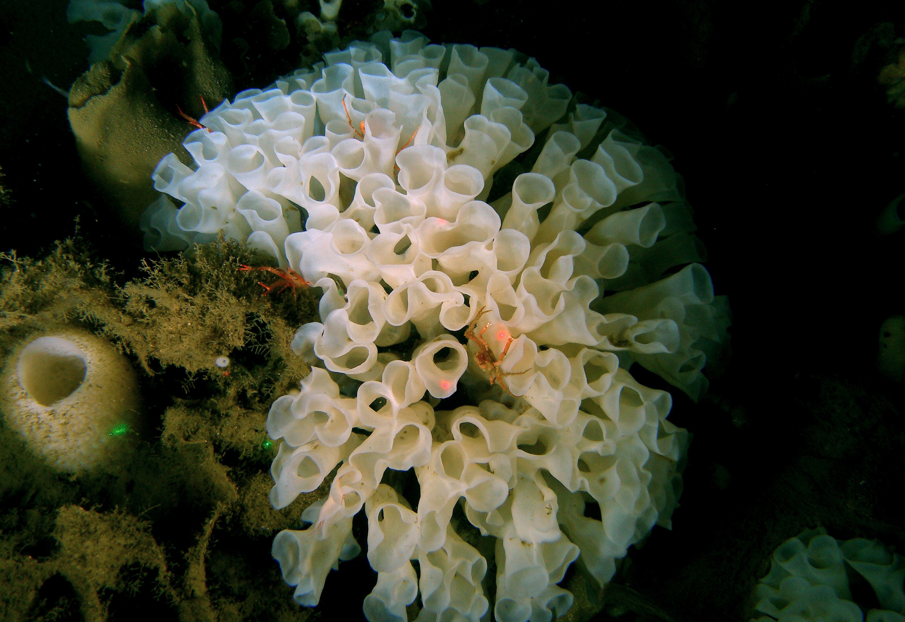
Are Ctenophores Sister to the Rest of Animals?
S. Leys
Dunn et al., 2008
Notes:
-I first became interested in gene loss due to an evolutionary biology mystery. About 11 years ago, Casey published the first paper suggesting that ctenophores, rather than sponges, are sister to the rest of animals.

Slide 3
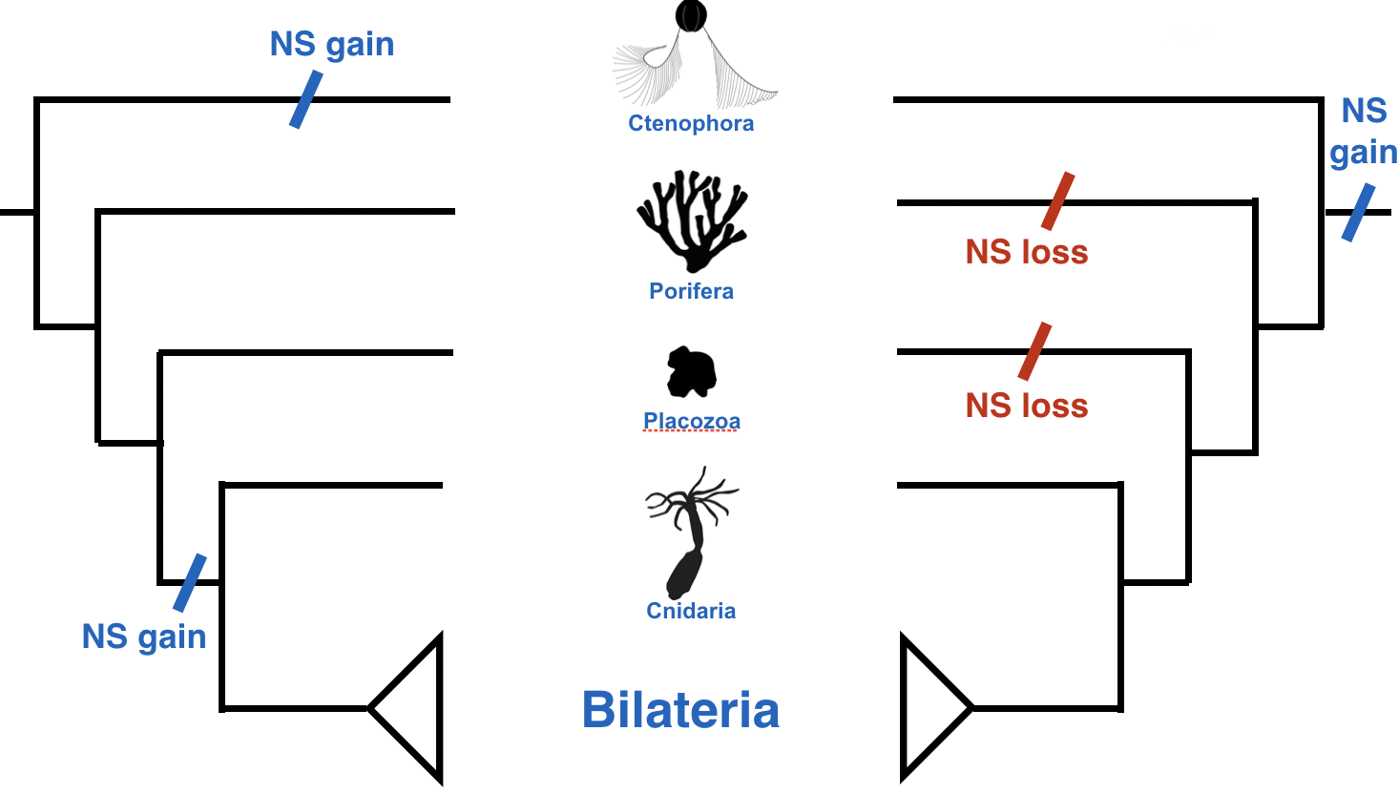
Gene Loss
phylopic.org
Notes:
-But ctenophores have nervous systems, while sponges and placozoans do not.
-So if ctenophores are sister, then either the nervous system arose twice, once in teh lineage to ctneophores and once in teh lineage to cnidarians, or the nervous system was lost twice, once in sponges and once in trichoplax.
Loss is usually established through the branching pattern of the phylogeny, but in this case branching pattern is in dispute. What if there is another way to establish loss?

Slide 4
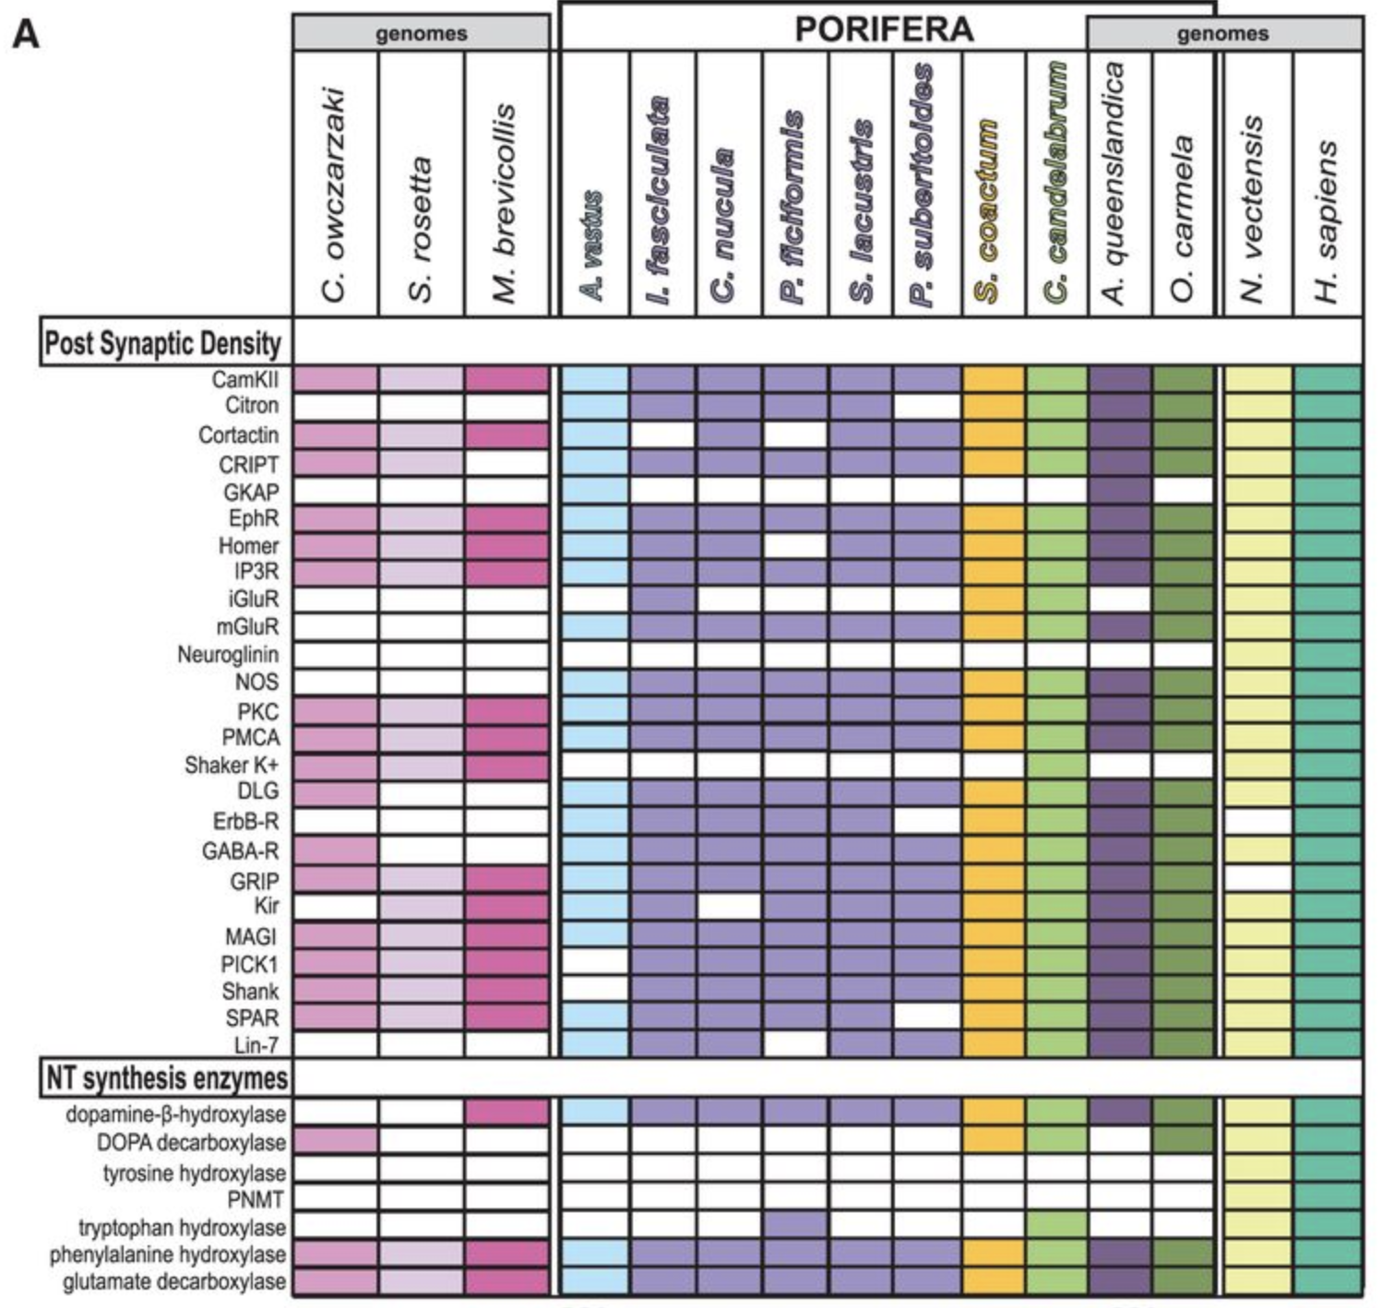
Sponges Have Some “Neural” Genes
Riesgo et al. 2014
Notes:
-Sponges might not have nervous systems, but they have many nervous system genes.
-Those who claim that sponges lost nervous systems point to this fact.
-But sponges are still missing many nervous system genes. Is this because they were never there, or because they were lost?
-Other than pointing out that sponges lack most neural genes in their genomes, is there another way to establish that sponges have indeed lost neural genes (rather than never had them in the first place)?
-This is what lead me to my Comp Gen project

Slide 5
Defining Gene Loss by Synteny Analysis
Gene 1
Gene 2
Gene 3
Animal 1 Scaffold
Animal 2 Scaffold
Gene 1
Gene 3
Synteny Block
Notes:
-One way to establish loss is to do synteny analysis and look for ghost loci
-Synteny analysis can be used to establish whether two chunks of DNA in different animals are homologous - this is called a syntenic block. You can establish synteny by the presence and order/collinearity of orthologous genes.
-If a gene is missing but all the genes one either side of it are present, you can conclude that that gene was lost - this is the case for gene 2 in animal 2.

Slide 6
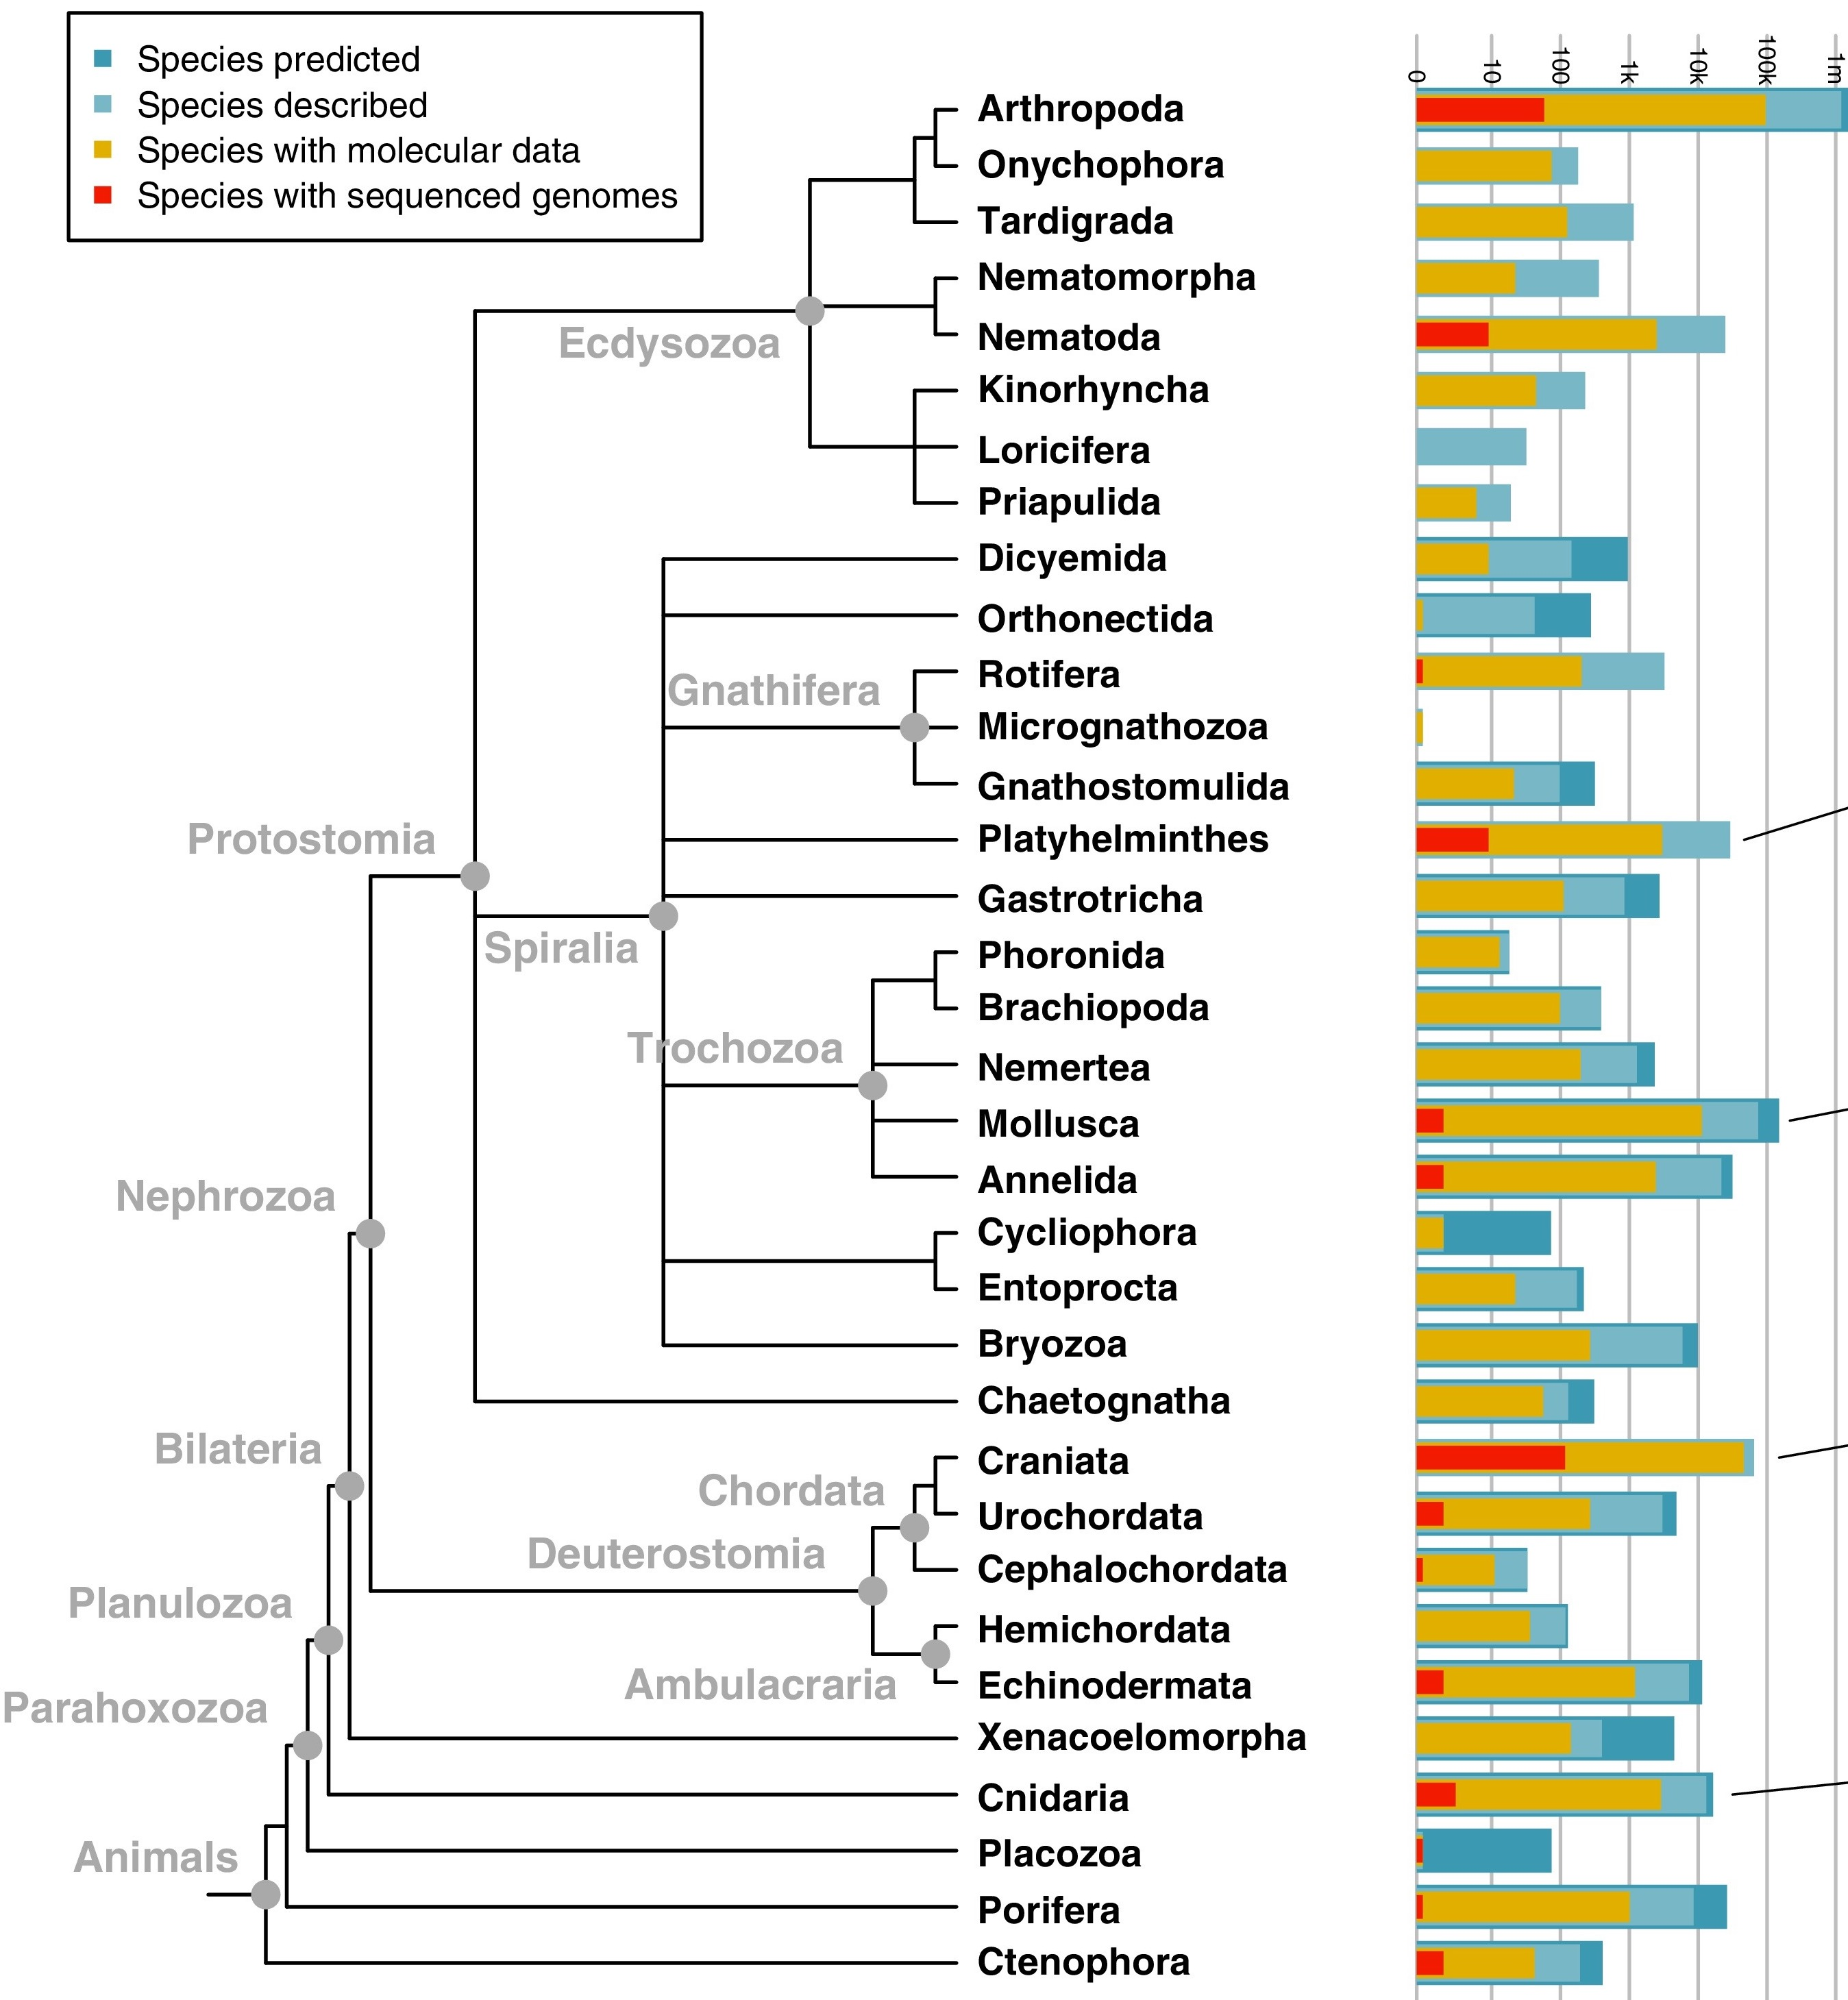
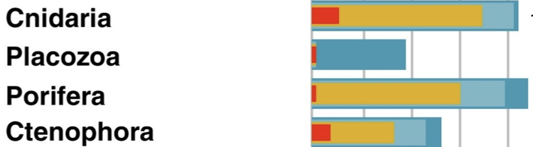
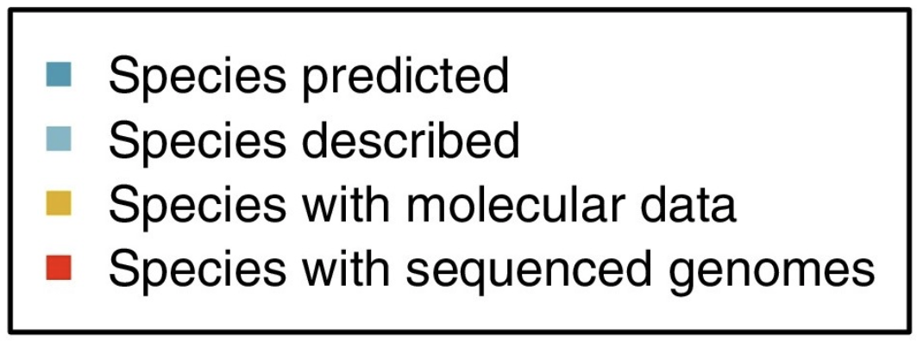
The Animal Tree is Under Sampled
0
10
100
1k
10k
Dunn and Ryan 2015, Curr. Op. Gen. & Dev.
Notes:
Before we look at synteny, let’s look at what we have to work with.
There is a shortage of genomes across the animal tree.
In particular, I am interested in looking at non-bilaterians
Currently: 7 Cnidarian, 2 Placozoans, kinda 4 Poriferan, and 2 Ctenophore genomes - in states of various quality and completeness

Slide 7
Broad Sampling of Animals
Mnemiopsis leidyi
Amphimedon queenslandica
Trichoplax adhaerens
Nematostella vectensis
Lottia gigantea
Capitella telata
Helobdella robusta
Drosophila melanogaster
Strongylocentrotus purpuratus
Danio rerio
Homo sapiens
Taeniopygia guttata
Notes:
-animals I’m working with.
-chosen to represent a broad sampling of animal tree.
-practicality: ensembl - have all file types and files have same format - easier to parse

Slide 8
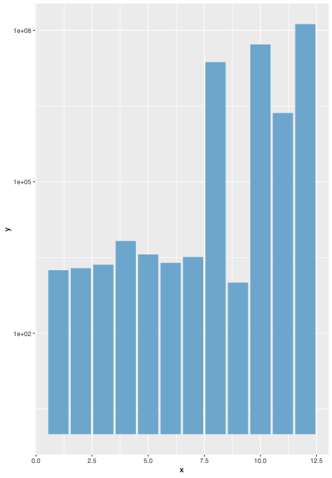
Most Genomes Have Short Scaffolds
Median Scaffold Length Per Assembly
133M
1e+08
1e+05
6707.5
Median Scaffold Length (Log10)
1772
2278.5
1939
1e+02
Mle
Aqu
Tad
Nve
Lgi
Cte
Hro
Dme
Spu
Dre
Tgu
Hsa
Notes:
I downloaded my genomes from Ensembl, and I found that in general most genomes have short scaffolds.
On left: median scaffold length for each assembly, on a log scale. Ranges from under 2000 in most genomes to 133M in humans. Notice that all the big spikes are the model organisms (and Taeniopygia guttata, which for some reason had a very high quality genome)
On the right is an example of the distribution of scaffold lengths in an animal - Mnemiopsis.

Slide 9
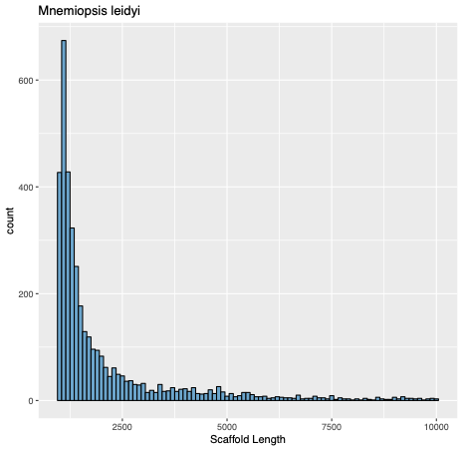
Most Genomes Have Short Scaffolds
Median Scaffold Length Per Assembly
Distribution of Scaffold Lengths in Mnemiopsis
133M
1e+08
800
1e+05
Frequency
400
6707.5
Median Scaffold Length (Log10)
1772
2278.5
1939
200
1e+02
0
2500
5000
7500
10000
Mle
Aqu
Tad
Nve
Lgi
Cte
Hro
Dme
Spu
Dre
Tgu
Hsa
scaffold length (bp)
Notes:
I downloaded my genomes from Ensembl, and I found that in general most genomes have short scaffolds.
On left: median scaffold length for each assembly, on a log scale. Ranges from under 2000 in most genomes to 133M in humans. Notice that all the big spikes are the model organisms (and Taeniopygia guttata, which for some reason had a very high quality genome)
On the right is an example of the distribution of scaffold lengths in an animal - Mnemiopsis.

Slide 10
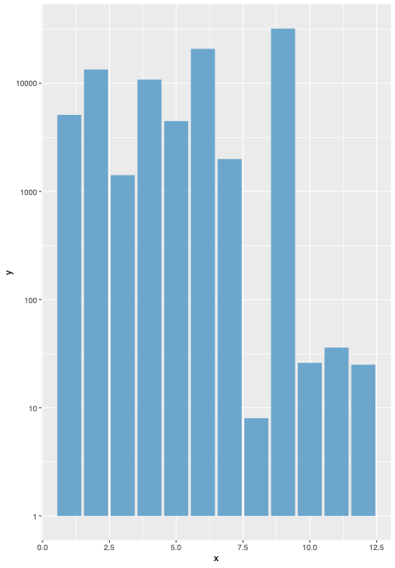
Most Genomes Are Fragmented
32,000
10000
1000
Number of Scaffolds (Log 10)
100
10
8
1
Mle
Aqu
Tad
Nve
Lgi
Cte
Hro
Dme
Spu
Dre
Tgu
Hsa
Notes:
Perhaps not surprisingly, most assemblies are fragmented. On the x-axis are the genome assemblies and the y-axis shows the number of scaffolds per genome assembly.
Range from 8 (drosophila) 32,000 Strongylocentrotus

Slide 11
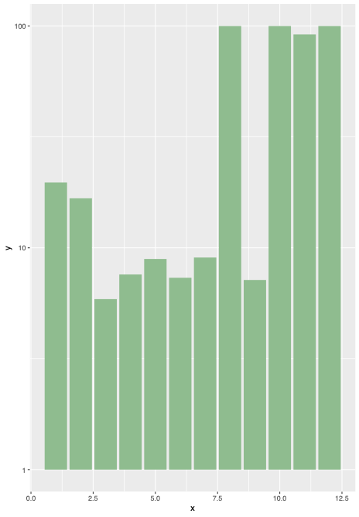
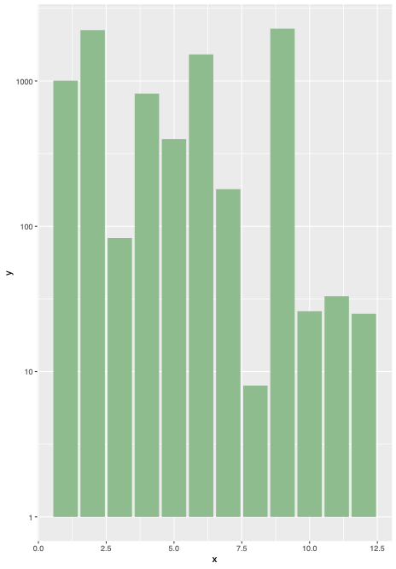
Synteny Analysis Requires At Least 3 Genes
100
1000
20%
17%
100
% Scaffolds with At Least 3 Genes
No. Scaffolds with At Least 3 Genes
10
8%
6%
10
1
1
Mle
Tad
Nve
Lgi
Cte
Hro
Dre
Tgu
Hsa
Mle
Aqu
Tad
Nve
Lgi
Cte
Hro
Dre
Tgu
Hsa
Aqu
Dme
Spu
Dme
Spu
Notes:
For synteny analysis to work, you need at least three genes on the reference: two on either side to anchor the synteny block, and the gene that is missing is in the middle.
Q: To what degree is synteny analysis even possible in my genomes?
On the left is the proportion of scaffolds that have at least 3 or more genes in each animal.
Prop: Trichoplax: ~6%
Model organisms: Drosophila, zebrafish, human: ~100%
But this can be misleading, because some animals have a lot of scaffolds, so on the right is the number of scaffolds with 3 or more genes in each animal.

Slide 12
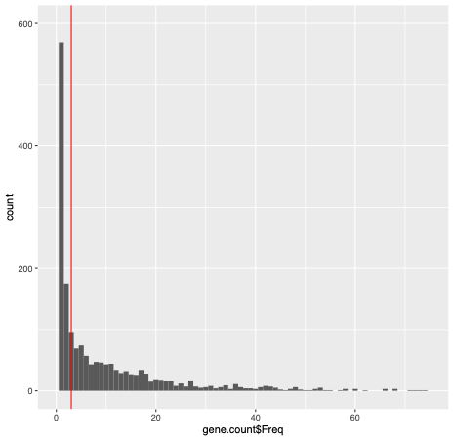
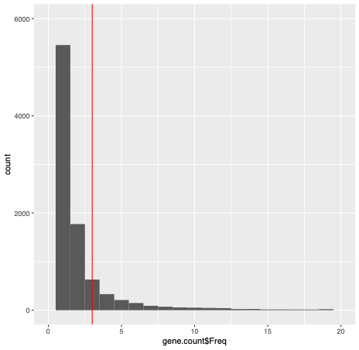
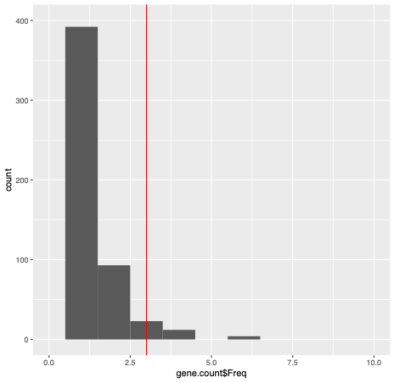
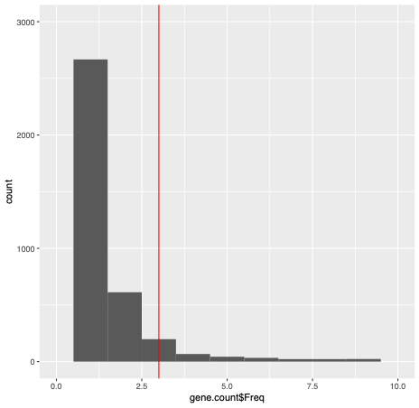
Distribution of the Number of Genes per Scaffolds
Mnemiopsis leidyi
Amphimedon queenslandica
Frequency
Trichoplax adhaerens
Nematostella vectensis
Number of Genes Per Scaffold
Notes:
And here is the distribution of the number of genes per scaffolds in each of the four non-bilaterians.
i.e. I counted how many scaffolds have 1, or 2, or 3 etc. genes
Red line is where scaffolds with 3 genes are placed. The point is that the median number of genes per scaffolds fall well before the red line.
Median genes per scaffold: 0,1,0,0

Slide 13
Synteny Analysis Overview
gff3 file
parse gene data
identify
ghost loci
aggregate
cluster
longest
sequences
homologs (Agalma)
peptide fasta

Slide 14
Synteny Analysis Overview
Part 1: Identify Homologous Genes on Scaffolds
gff3 file
parse gene data
identify
ghost loci
aggregate
cluster
longest
sequences
homologs (Agalma)
peptide fasta
Notes:
Part 1: We need to know which genes on which scaffolds are shared across different animals.

Slide 15
Synteny Analysis Overview
Part 1: Identify Homologous Genes on Scaffolds
Part 2: Identify Syntenic Scaffolds
z
gff3 file
parse gene data
identify
ghost loci
aggregate
cluster
longest
sequences
homologs (Agalma)
peptide fasta
Notes:
Part 1: We need to know which genes on which scaffolds are shared across different animals.
Part 2: Identify which scaffolds are homologous as a whole. We are defining synteny at the whole scaffold level.

Slide 16
Synteny Analysis Overview
Identify Each Gene On Scaffold
gff3 file
parse gene data
identify
ghost loci
aggregate
cluster
longest
sequences
homologs (Agalma)
peptide fasta
Notes:
Parse the GFF3 file to identify which genes are on which scaffold.

Slide 17
Identify Homologous Genes
Parse GFF3 Files
seqid
source
type
start
end
score
strand
attributes
scaffold_1
JGI
gene
1
300
-
+
gene_id=GeneName
scaffold_1
JGI
mRNA
2
100
-
+
transcript_id=TransName
scaffold_1
JGI
exon
50
80
-
+
exon_id= ProtName
scaffold_1
JGI
CDS
50
80
-
+
protein_id= ProtName
scaffold_1
JGI
pseudogene
300
350
-
+
gene_id=GeneName
Notes:
For each genome, you have a GFF3 file. GFF3 file is the annotation file for a genome.
GFF3 file rich in information -ex.
-lists not just genes but all features that can be found on a scaffold
what I wanted: list of each scaffold’s genes
-filter by type = gene
-grep gene name from attributes: gene_id=

Slide 18
Identify Homologous Genes
Parse GFF3 Files
seqid
source
type
start
end
score
strand
attributes
scaffold_1
JGI
gene
1
300
-
+
gene_id=GeneName
scaffold_1
JGI
mRNA
2
100
-
+
transcript_id=TransName
scaffold_1
JGI
exon
50
80
-
+
exon_id= ProtName
scaffold_1
JGI
CDS
50
80
-
+
protein_id= ProtName
scaffold_1
JGI
pseudogene
300
350
-
+
gene_id=GeneName
Notes:
GFF3 file rich in information -ex.
-lists not just genes but all features that can be found on a scaffold
what I wanted: list of each scaffold’s genes
-filter by type = gene
-grep gene name from attributes: gene_id=

Slide 19
Identify Homologous Genes
Parse GFF3 Files
seqid
source
type
start
end
score
strand
attributes
scaffold_1
JGI
gene
1
300
-
+
gene_id=GeneName
scaffold_1
JGI
mRNA
2
100
-
+
transcript_id=TransName
scaffold_1
JGI
exon
50
80
-
+
exon_id= ProtName
scaffold_1
JGI
CDS
50
80
-
+
protein_id= ProtName
scaffold_1
JGI
pseudogene
300
350
-
+
gene_id=GeneName
Notes:
GFF3 file rich in information -ex.
-lists not just genes but all features that can be found on a scaffold
what I wanted: list of each scaffold’s genes
-filter by type = gene
-grep gene name from attributes: gene_id=

Slide 20
Identify Homologous Genes
Parse GFF3 Files
Animal 1 Scaffold
Notes:
Identify the genes on a scaffold

Slide 21
Identify Homologous Genes
Parse GFF3 Files
Scaffold ID + Gene Name
Gene 1
Gene 2
Gene 3
Animal 1 Scaffold
Notes:
We have identified the genes on the scaffold.

Slide 22
Synteny Analysis Overview
gff3 file
parse gene data
identify
ghost loci
aggregate
cluster
longest
sequences
homologs (Agalma)
peptide fasta
Identify Homologous Genes
Notes:
Second step is to find out which genes are homologous to each other.
Took peptide fasta from each genome, found the longest sequence for each gene, and found homologs by Agalma.

Slide 23
Identify Homologous Genes
Identify Homologs: Agalma
Animal A
Animal B
homology_id
gene
catalog_id
geneH
geneA
1
geneE
Animal1
geneB
geneG
geneF
1
geneG
Animal2
geneE
geneC
geneJ
geneD
geneI
All vs All BLAST: Define homologs as Reciprocal Best Hits
Notes:
-Agalma identifies homologous genes doing an all vs all blast of all the peptides
-Homologs defined as reciprocal best hits.
-RBH: If blast gene E from animal A to animal B, and gene G is the best hit. Then gene E in Animal A must be the best hit whe gene G is blasted to A.
-Paralogs have same homology_id
-I get a table that looks something like this.

Slide 24
Identify Homologous Genes
Identify Homologs: Agalma
Gene Name + Homology ID
Gene 1
Gene 2
Gene 3
Animal 1 Scaffold
Animal 2 Scaffold
Gene 1
Gene 3
Notes:
Identify which genes are homologous across animals.
i.e. we know the blue gene is homologous to the other blue gene in animal 2, and likewise for the green gene.

Slide 25
Synteny Analysis Overview
]
gff3 file
parse gene data
identify
ghost loci
aggregate
cluster
longest
sequences
homologs (Agalma)
peptide fasta
Notes:
Next step: amalgamate the two pieces of information.

Slide 26
Identify Homologous Genes
Aggregate Data
GFF3:
Scaffold ID + Gene Name
Gene 1
Gene 2
Gene 3
Animal 1 Scaffold
Notes:
We have identified the genes on the scaffold.

Slide 27
Identify Homologous Genes
Aggregate Data
Agalma:
Gene Name + Homology ID
Gene 1
Gene 2
Gene 3
Animal 1 Scaffold
Animal 2 Scaffold
Gene 1
Gene 3
Notes:
We have identified which genes are homologous to each other.

Slide 28
Identify Homologous Genes
Aggregate Data
Scaffold ID + Gene Name + Homology ID
Gene 1
Gene 2
Gene 3
Animal 1 Scaffold
?
Animal 2 Scaffold
Gene 1
Gene 3
Notes:
Now we know each gene on each scaffold, and which genes are homologous to each other in different animals.
But we still don’t know if the scaffolds themselves (i.e. the entire block) are homologous.

Slide 29
Synteny Analysis Overview
Part 2: Identify Syntenic Scaffolds
gff3 file
parse gene data
identify
ghost loci
aggregate
cluster
longest
sequences
homologs (Agalma)
peptide fasta
Notes:
Part 1: We need to know which genes on which scaffolds are shared across different animals.
Part 2: Identify which scaffolds are homologous as a whole. We are defining synteny at the whole scaffold level.
We defined two scaffolds as syntenic if they clustered together based on which genes they possessed. The more genes they share, the more likely they are to cluster together, and the more likely they are to be homologous/syntenic.

Slide 30
Identify Syntenic Scaffolds
Clustering
contingency
matrix
homologs
scaffold
1 0 0 1 1 …
1
0
1
…
1 = homolog present in scaffold
0 = homolog absent in scaffold
Notes:
Clustering requires three steps
-first make a contingency matrix. This is a matrix where all the homologs are listed on top, and scaffolds are listed on the side. You put a 1 if the homolog is present on the scaffold, and a 0 if it is absent.

Slide 31
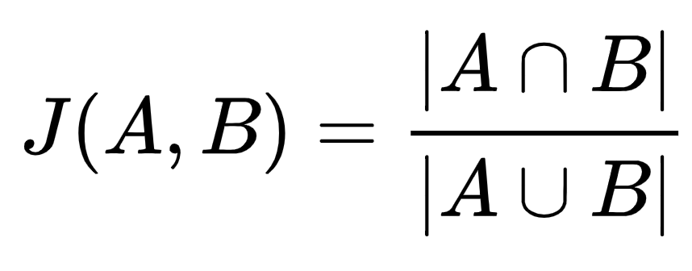
Identify Syntenic Scaffolds
Clustering
contingency
matrix
similarity
matrix
jaccard matching coefficient
homologs
scaffold
1 0 0 1 1 …
1
0
1
A
B
…
1 = homolog present in scaffold
0 = homolog absent in scaffold
randomly sample 100x100 matrix
Notes:
-similarity matrix: how similar are each scaffold to each other? Homologous scaffolds should be most similar.
-jaccard matching coefficient: measures similarity between two things as the overlap/intersection between A and B divided by the union of A and B.

Slide 32
Identify Syntenic Scaffolds
Clustering
contingency
matrix
similarity
matrix
clustering
algorithm
Cross-Clustering
jaccard matching coefficient
(Tellarolli et al. 2016)
homologs
scaffold
1 0 0 1 1 …
1
0
1
A
B
syntenic blocks defined
by cluster ID
…
1 = homolog present in scaffold
0 = homolog absent in scaffold
Notes:
Then used a clustering algorithm to define groups of syntenic scaffolds.
-Cross-clustering: it is a hierarchical aggregative algorithm that mixes elements of Ward’s minimum variance and Complete-linkage clustering algorithms. It is supposed to be good for being robust to outliers and not requiring a priori knowledge of how many clusters there should be.

Slide 33
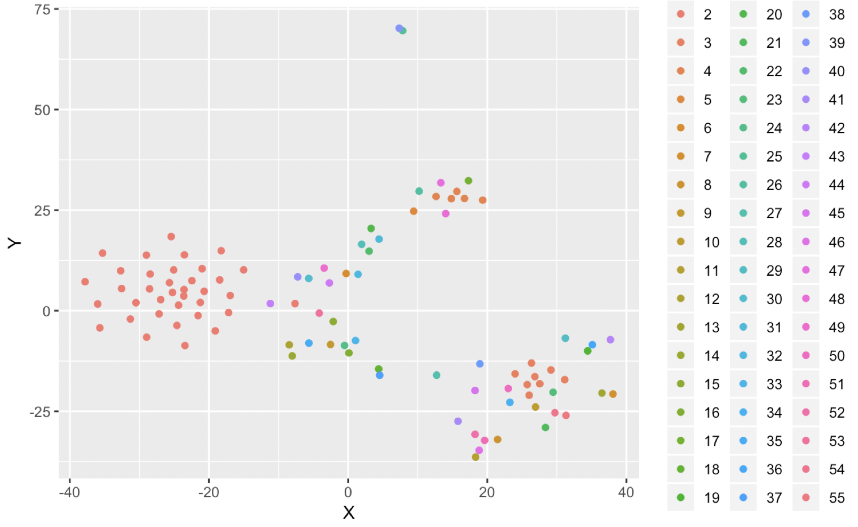
Identify Syntenic Scaffolds
Clustering Results
Homo sapiens, Danio rerio, Strongylocentrotus purpuratus (100x100 sample)
Visualized by tSNE, clustered by Cross-Clustering
One major cluster. Many small clusters
Scaffolds that cluster together
are syntenic.
Notes:
Visualization by tSNE - graphical way of displaying the clustering structure of data- kind of corresponds to cross-clustering results.
*Points are coloured according to clusters defined by cross-clustering* = this is what I am using as cluster identity
Subset: Only scaffolds from human, zebrafish, sea star, randomly sampled 100 scaffolds and 100 homologs. Otherwise couldn’t run on computer. - Need to figure out how to run on cluster.
Cross-clustering gave me 1 big cluster, and then many small clusters that had a membership of 1. Suggests clustering did not work. Clustering is an issue currently troubleshooting (I’ll get into if we have time).
We’ve defined scaffolds that cluster together as syntenic.

Slide 34
Identify Homologous Genes
Combine Homology and Clustering Data
Gene Name + Homology ID
Gene 1
Gene 2
Gene 3
Animal 1 Scaffold
Animal 2 Scaffold
Gene 1
Gene 3
Notes:
We found which genes are homologous across animals

Slide 35
Identify Homologous Genes
Combine Homology and Clustering Data
Gene Name + Homology ID
+ Scaffold ID
Gene 1
Gene 2
Gene 3
Animal 1 Scaffold
?
Animal 2 Scaffold
Gene 1
Gene 3
Notes:
Know which genes go on which scaffold. And, by identifying similar scaffolds by clustering their gene content,

Slide 36
Identify Homologous Genes
Combine Homology and Clustering Data
Gene Name + Homology ID
+ Scaffold ID
+ Cluster ID
Gene 1
Gene 2
Gene 3
Animal 1 Scaffold
Animal 2 Scaffold
Gene 1
Gene 3
Notes:
We know which scaffolds are homologous syntenic blocks.

Slide 37
Synteny Analysis Overview
gff3 file
parse gene data
identify
ghost loci
aggregate
cluster
longest
sequences
homologs (Agalma)
peptide fasta

Slide 38
Find Ghost Loci
1. Define a reference and a comparison animal. Find all scaffolds in the comparison animal
that share the cluster ID (synteny) of the reference.
Notes:
-reference vs comparison: ie which animal comparing to which

Slide 39
Find Ghost Loci
1. Define a reference and a comparison animal. Find all scaffolds in the comparison animal
that share the cluster ID (synteny) of the reference.
2. Compare each gene in the reference scaffold to all genes in the comparison scaffold and
note which are missing.

Slide 40
Find Ghost Loci
1. Define a reference and a comparison animal. Find all scaffolds in the comparison animal
that share the cluster ID (synteny) of the reference.
2. Compare each gene in the reference scaffold to all genes in the comparison scaffold and
note which are missing.
3. Check that reference genes absent in the comparison scaffold did not arise after the
comparison animal.
Notes:
Many reasons a gene may be absent, one being that it simply arose after the emergence of the comparison animal.

Slide 41
Nesting Index
1
Mnemiopsis leidyi
2
Amphimedon queenslandica
3
Trichoplax adhaerens
4
Nematostella vectensis
6
Lottia gigantea
7
Capitella telata
7
Helobdella robusta
5
Drosophila melanogaster
5
Strongylocentrotus purpuratus
6
Danio rerio
7
Homo sapiens
7
Taeniopygia guttata
Notes:
System I came up with.
Assigned a number to each taxon depending on how nested it was in the tree. The more nested, the higher the number.
Then, for each homolog absent in the comparison scaffold, I checked whether it was present in an animal with a nesting index that was lower or equal to the comparison animal.
Yesterday noticed flaw: only works if animal is sandwiched (i.e. reference is more derived than comparison)?

Slide 42
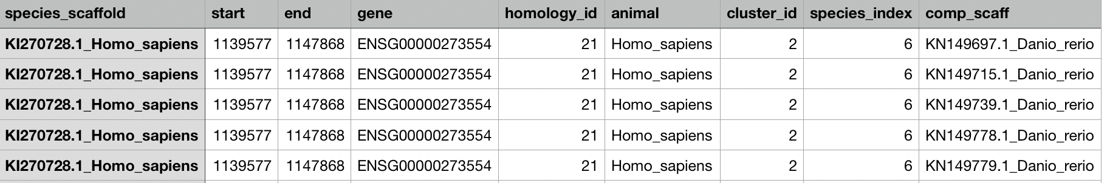
Find Ghost Loci
1. Define a reference and a comparison animal. Find all scaffolds in the comparison animal
that share the cluster ID (synteny) of the reference.
2. Compare each gene in the reference scaffold to all genes in the comparison scaffold and
note which are missing.
3. Check that reference genes absent in the comparison scaffold did not arise after the
comparison animal.
4. List all absent genes = “ghost loci”.

Slide 43
Future Questions
Test system-specific questions eg. Did sponges lose neural genes or were they always absent?
Characterize the lost genes: new vs old, shorter, less optimal codons? Paralogs vs Orthologs? Link to GO terms (specific function lost?)
Is there anything that characterizes gene loss in parasites vs sponges, placozoans?

Slide 44
What’s Going On With Clustering?!!
Data
Distance Metric
Clustering Algorithm
gower
relaxed bitscore
5 taxa
cross-clustering
kmeans
agnes
diana
Notes:
Tried two different kinds of data.
Three extra different kinds of clustering algorithms.

Slide 45
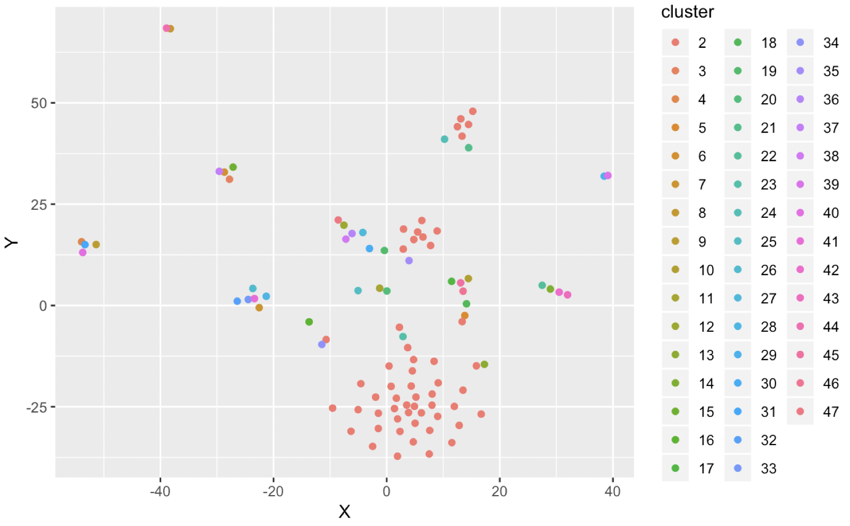
Troubleshooting: Data
relaxed bitscore cutoff (100)
5 taxa: Hsa, Tgu, Dne, Spu, Dre
cross-clustering performed on 100 data points
Notes:
Relaxed bit score: all vs all blast in Agalma, relaxed bit score = lowered threshold for defining genes as homologous.
5 taxa: only ran five closely related taxa through Agalma

Slide 46
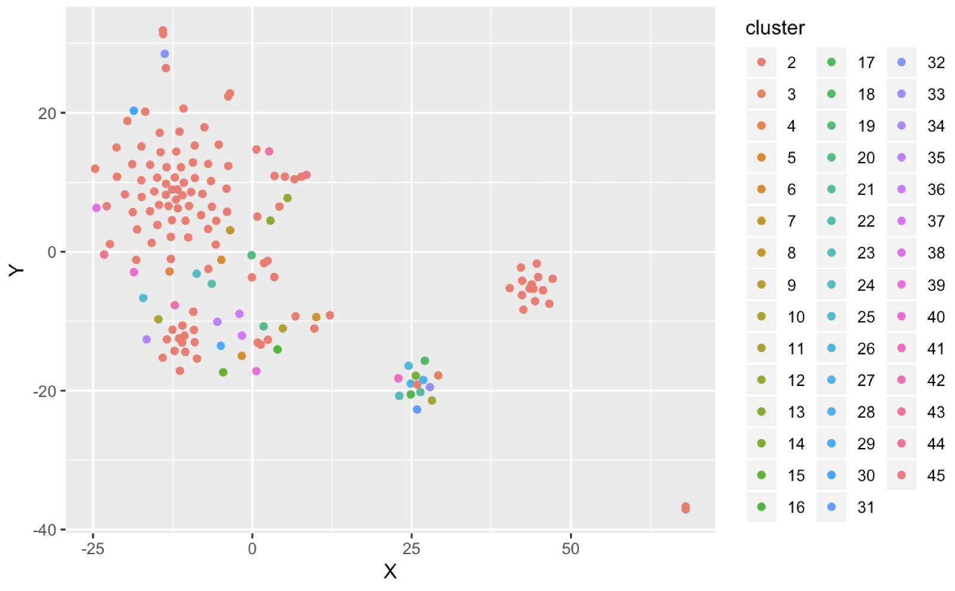
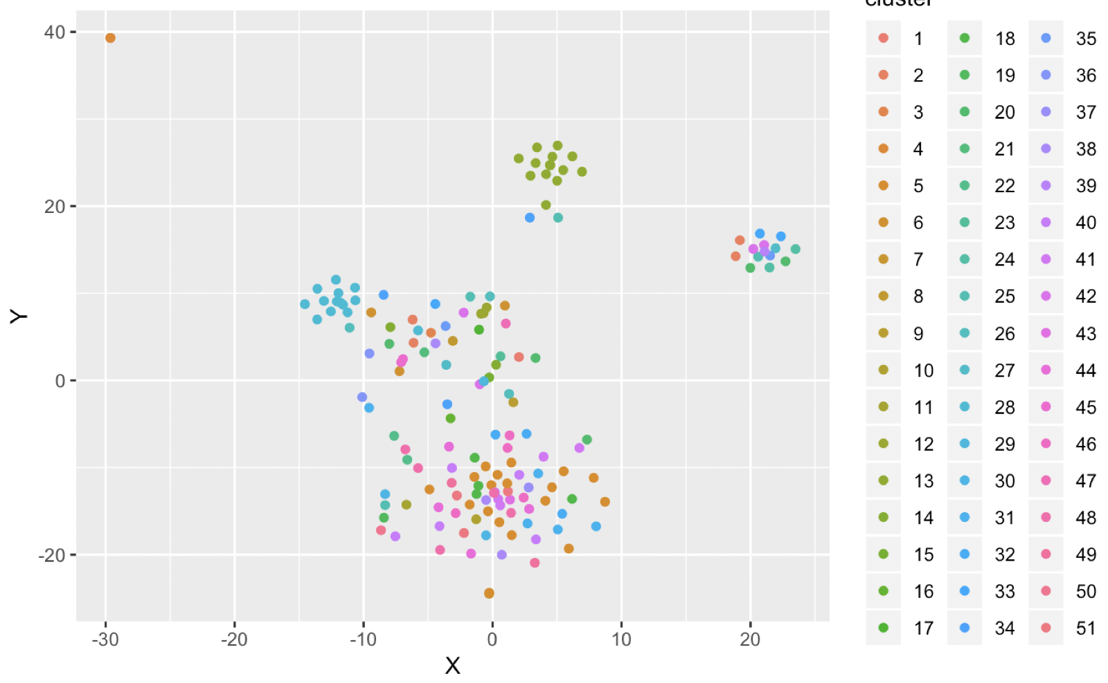
Troubleshooting: Clustering Algorithms
cross-clustering
kmeans
Used Agalma on Hsa, Tgu, Dre, Spu, Dme. Clustered only Hsa and Dre
Notes:
Used Agalma on Hsa, Tgu, Dre, Spu, Dme. Clustered only Hsa and Dre - gave best chance of clustering
Kmeans: interesting that clusters matched tSNE clusters
-uncomfortable with specifying the number of clusters (elbow graph)

Slide 47
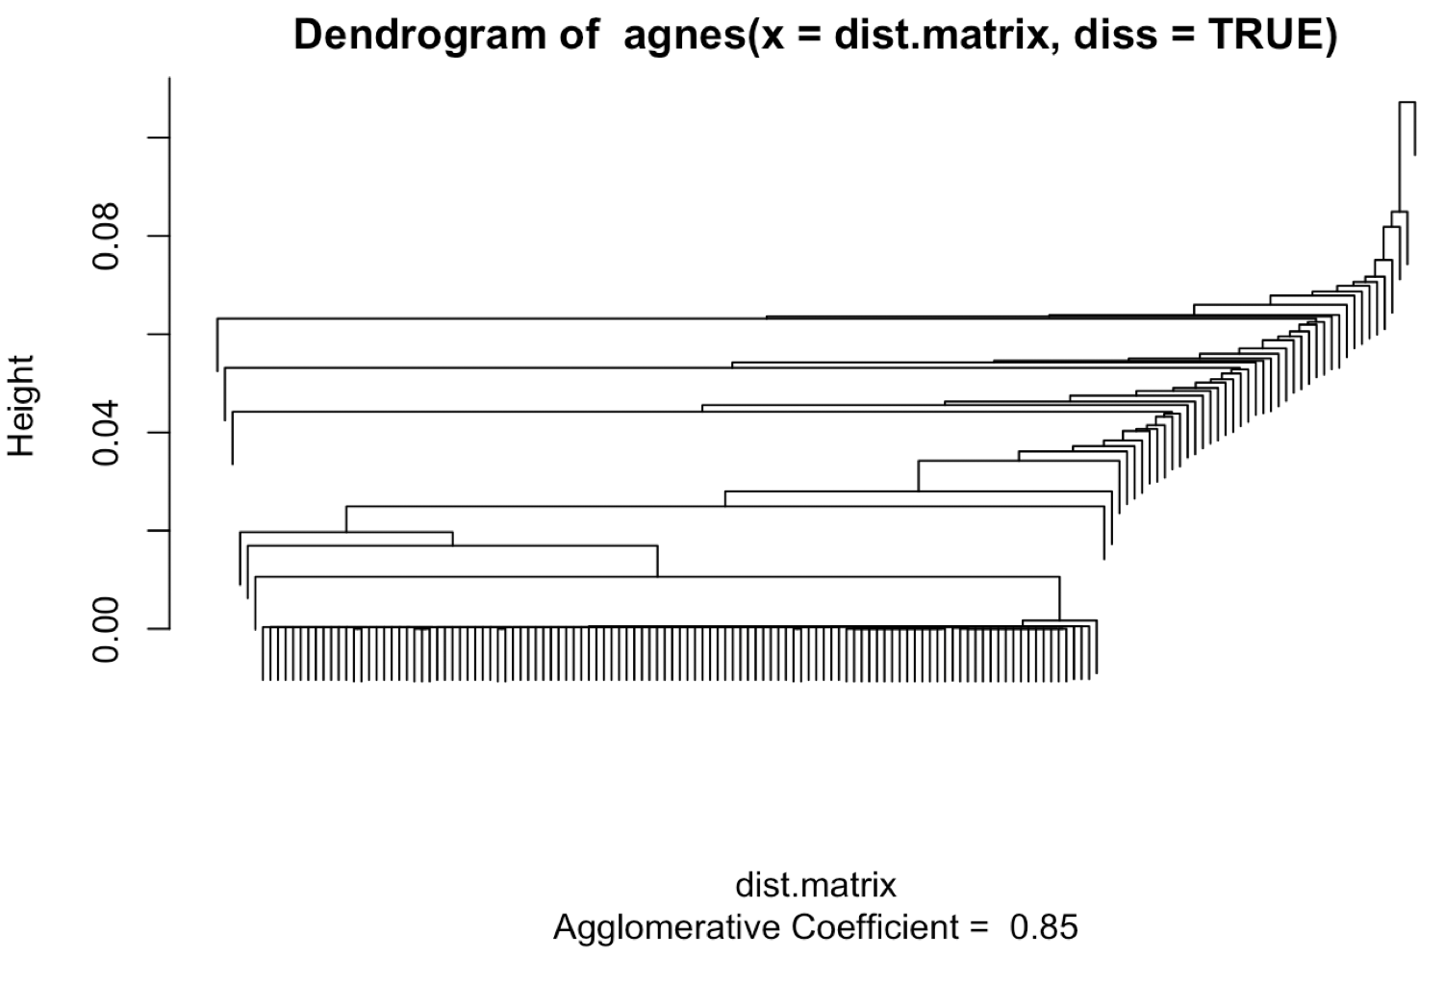
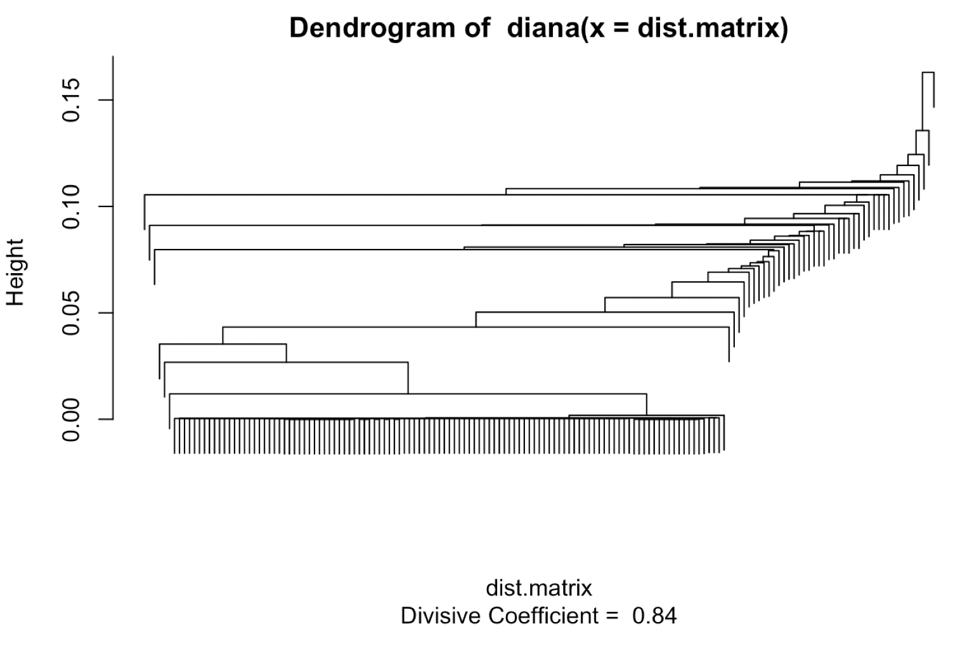
Troubleshooting: Clustering Algorithms
Agglomerative hierarchical clustering (agnes)
Divisive hierarchical clustering (diana)
Used Agalma on Hsa, Tgu, Dre, Spu, Dme. Clustered only Hsa and Dre
Notes:
Tried an ag. hierarchical clustering algorithm (agnes) and divisive hierarchical clustering algorithm (diana)
-agglomerative: you start with each point being defined as a cluster then joining the closest points into each cluster
-divisive: all points in one cluster, then chop off the most distant points into separate clusters
You can see why things get clumped together in 1 big clump, then break off into many clumps of 1.

Slide 48
Moving Forward
Sparse clustering algorithms
Antonio’s idea
Null hypothesis: randomized contingency matrix

Slide 49
Identify Homologous Genes
Aggregate
Agalma output
GFF3 file
seqid
gene
homology_id
animal
Aqu_scaffold1
AquGeneName
1
Amphimedon queenslandica
Mle_scaffold1
MleGeneName
1
Mnemiopsis leidyi
Spu_scaffold1
SpuGeneName
2
Strongylocentrotus purpuratus
Dre_scaffold1
DreGeneName
3
Danio rerio
Hsa_scaffold1
HsaGeneName1
N/A
Homo sapiens
Hsa_scaffold2
HsaGeneName2
4
Homo sapiens
Tad_scaffold1
TadGeneName
5
Trichoplax adhaerens
Notes:
What is the important thing to look at here:

Slide 50
Identify Homologous Genes
Simplify Master Table
Agalma output
GFF3 file
seqid
gene
homology_id
animal
Aqu_scaffold1
AquGeneName
1
Amphimedon queenslandica
Mle_scaffold1
MleGeneName
1
Mnemiopsis leidyi
Spu_scaffold1
SpuGeneName
2
Strongylocentrotus purpuratus
Dre_scaffold1
DreGeneName
3
Danio rerio
Hsa_scaffold1
HsaGeneName1
3
Homo sapiens
Hsa_scaffold2
HsaGeneName2
4
Homo sapiens
Tad_scaffold1
TadGeneName
5
Trichoplax adhaerens

Slide 51
Identify Homologous Genes
Aggregate
Scaffold ID + Gene Name
(GFF3 file)

Slide 52
Identify Homologous Genes
Aggregate
Scaffold ID + Gene Name
(GFF3 file)
+
(Agalma)
Gene Name + Homology ID

Slide 53
Identify Homologous Genes
Aggregate
Scaffold ID + Gene Name
(GFF3 file)
+
(Agalma)
Gene Name + Homology ID
=
Scaffold ID + Gene Name + Homology ID + Animal ID

Slide 54
Identify Syntenic Scaffolds
Workflow
gff3 file
parse gene data
identify
ghost loci
aggregate
cluster
longest
sequences
homologs (Agalma)
peptide fasta

